Slide 1
18CSC304J COMPILER DESIGN
UNIT 5
SESSIONS 7(b), 8

Slide 2
Topics that will be covered
Introduction to Global Data Flow Analysis
Computation of gen and kill
Computation of in and out

Slide 3
INTRODUCTION TO GLOBAL DATA FLOW ANALYSIS

Slide 4
Introduction to Global Data Flow Analysis
To do code optimization, a compiler needs to collect information about the program as a whole and to distribute this information to each block in the flow graph
An optimizing compiler collects data-flow information by a process known as data-flow analysis
Data flow information is information such as
Information about what variables are live on exit from each block
Information such as where a variable was last defined before reaching a given block
How to find redundant computations
Data flow information may be collected by setting up and solving systems of equations that relate information at various points in a program

Slide 5
Points and Paths
Points
Within a basic block, we talk of the point between two adjacent statements as well as the pointer before the first statement and after the last
Example: Consider the block
This block has 4 points
Before d1
After d4
After d2
After d3
Paths
Take a global view and consider all the points in all the blocks
A path from p₁ to p_{n} is a sequence of points p₁, p₂, …, p_{n} such that
p_{i} is the point immediately preceding a statement and p_{i+1} is the point immediately following the statement in the same block
p_{i} is the end of some block and p_{i+1} is the beginning of a successor block
p₁
d1 : t1 := m – 1
d2 : j := n
d3 : a := u1
p₂
p₃
p₄

Slide 6
Reaching Definitions
A definition of a variable x is a statement that assigns, or may assign a value to x
The most common forms of definition are assignments to x and statements that read a value from an I/O device and store it in x
There are two types of definitions:
Unambiguous Definitions
Statements that certainly define a value for x.
Example for unambiguous definitions
Ambiguous Definitions
Statements that may define a value for x are called ambiguous definitions
Example:
A call of a procedure with x as a parameter or a procedure that can access x because x is in the scope of the procedure
An assignment through a pointer that could refer to x
d1 : t1 := m – 1
d2 : j := n
d3 : a := u1

Slide 7
Reaching Definitions – cont..
Reaching Definitions
A definition d reaches a point p if there is a path from the point immediately following d to p such that d is not killed along that path
Killing a Definition
We kill a definition of a variable a if between two points along the path there is a definition of a
Conservative decision
In the face of any doubt, we must make only conservative decisions
A decision is conservative if it never leads to a change in what the program computes
Conservative decisions may sometimes cause us to miss some transformations
In applications of reaching definitions, it is normally conservative to assume that a definition can reach a point even if it might not

Slide 8
Data Flow Analysis of Structured Programs
Flow graphs for control-flow constructs such as do-while statements have a useful property : there is a single beginning point at which control enters and a single end point at which control leaves
Region
A portion of a flow graph called a region is a set of nodes N that includes a header, which dominates all other nodes in the regions
All edges between nodes in N are in the region, except for some that enter the header
Data Flow Equations for reaching definition
Consider the syntax
S → id := E | S ; S | if E then S else S | do S while
E → id + id | id

Slide 9
Data Flow Analysis of Structured Programs – contd..
Data Flow Equations
Data flow equations are equations of the form
out[S] = gen[S] U ( in[S] – kill[S] ) ---------- (1)
where
gen[S] → information generated within the statement
in[S] → information that enters at the beginning of the statement
out[S] → information at the end of a statement
kill[S] → information that is killed as control flows through the statement
Equation (1) can be read as
“Information at the end of a statement is either generated within the statement or enters at the beginning and is not killed as control flows through the statement”
Such equations are called data-flow equations

Slide 10
COMPUTATION OF gen & kill

Slide 11
Computation of gen & kill
gen[S] and kill[S] are synthesized attributes;
They are computed bottom-up, from the smallest statements to the largest
gen[S] is the set of definitions generated by S, ie., the definition d is in gen[S] if it appears in S and reaches the end of S
kill[S] is the set of definitions that never reach the end of S, even if they reach the beginning

Slide 12
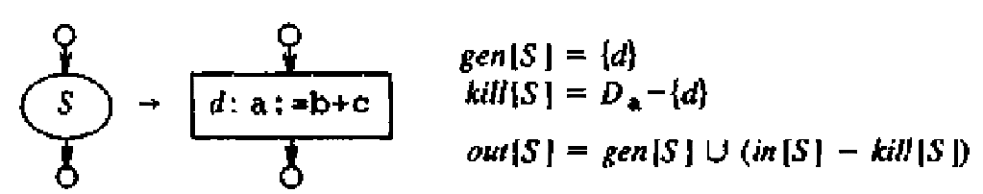
Computation of gen & kill in different cases
Simple Statement
d is the only definition sure to reach the end of S
So, gen[S] = { d }
d kills all other definitions of a
So, kill[S] = Da – { d }
where Da is the set of all definitions in the program for variable a
1

Slide 13
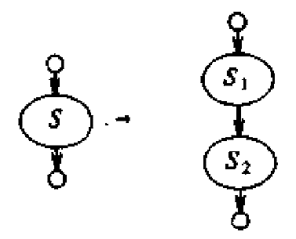
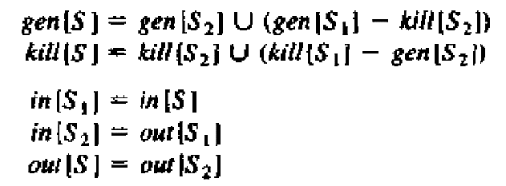
Computation of gen & kill in different cases – cont..
Cascade of Statements
We can observe the following:
in[S1] = in[S]
in[S2] = out[S1]
out[S] = out[S2]
2

Slide 14
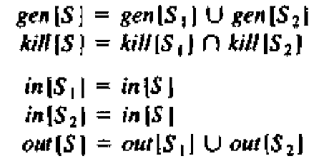
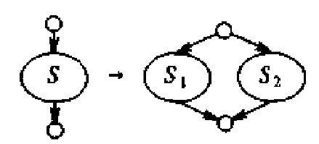
Computation of gen & kill in different cases – cont..
IF Statement
A definition reaches the beginning of S1 or S2 exactly when it reaches the beginning of S
Therefore,
in[S1] = in[S]
in[S2] = in[S]
A definition reaches the end of S if and only if it reaches the end of one or both substatements,
That is,
out[S] = out[S1] U out[S2]
3

Slide 15
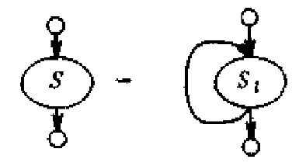
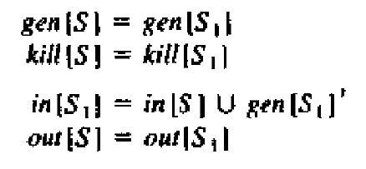
Computation of gen & kill in different cases – cont..
LOOP Statement
A definition that is in in[S] also reaches the beginning of S1. And, since there is a loop, the definitions generated in S1 also reach the beginning of S1. So,
in[S1] = in[S] U gen[S1]
A definitions that reach the end of S1 also reach the end of S
That is,
out[S] = out[S1]
4

Slide 16
Representation of the sets gen & kill
Sets of definitions such as gen[S] and kill[S] can be represented compactly using bit vectors
Definitions in flow graph are numbered
Then the bit vector representing a set of definitions will have 1 in position i if and only if the definition numbered i is in the set
A bit-vector representation allows set operations to be implemented efficiently
The union and intersection of 2 sets can be implemented by logical OR and logical AND respectively
The difference A-B of sets A and B can be implemented by taking the complement of B and then using logical AND to compute A AND NOT B

Slide 17
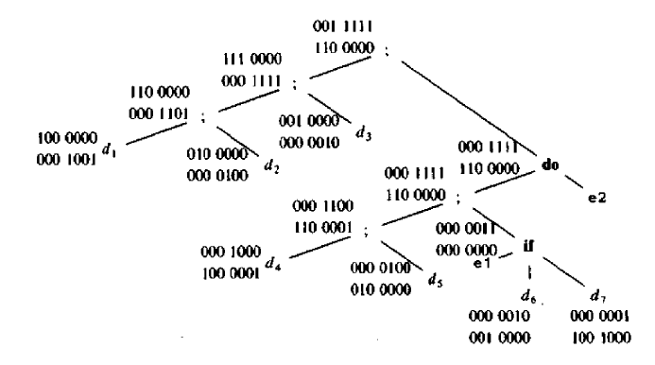
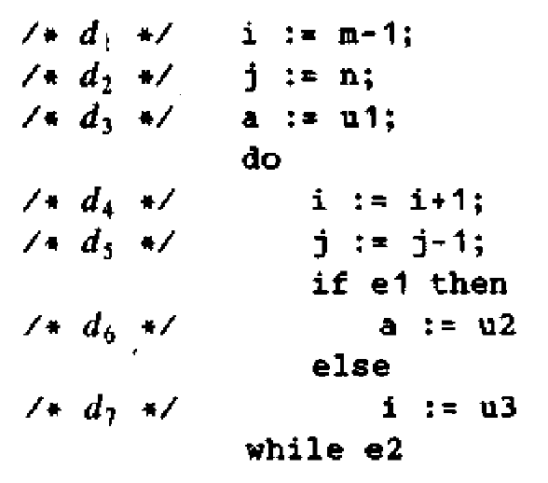
Representation of the sets gen & kill
Example:
After computing gen and kill, we can compute in and out, starting from the top of the parse tree. Assume that in set at the root of the tree is empty
gen
kill
gen
kill
gen
kill
gen
kill
gen
kill
gen
kill
gen
kill
gen
kill
gen
kill
gen
kill
gen
kill
gen
kill
gen
kill
gen
kill

Slide 18
Local Reaching Definitions
Consider a sequence of assignments S₁ ; S₂ ; … ; S_{n} in a basic block B
Basic blocks are usually treated as a unit, with attention restricted to only beginning points of blocks
Assume
p₀ → beginning point of B
p_{i} → points between statements S_{i} and S_{i+1}
p_{n} → point at end of the block
The definitions reaching point p_{j} can be obtained as follows
Initially, let D = in[B]
When S_{i} is considered, delete from D, the definitions killed by S_{i} and add the definitions generated by S_{i}
At the end, D consists of the definitions reaching p_{j}

Slide 19
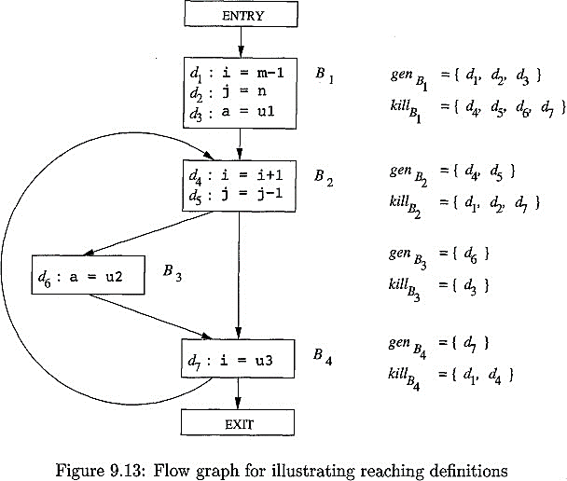
Flow Graph for illustrating reaching definitions

Slide 20
Use-Definition Chains (ud-chains)
The reaching definition information is stored as “use-definition chains” or “ud-chains”
ud-chains are lists, for each use of a variable, of all the definitions that reach that use
If a use of variable a in block B is preceded by no unambiguous definitions of a, then the ud-chain for that use of a is the set of definitions in in[B] that are definitions of a
If there are unambiguous definitions of a within B preceding this use of a, then only the last such definition of a will be on the ud-chain and in[B] is not placed on the ud-chain
In addition, if there are ambiguous definitions of a, then all of these for which no unambiguous definition of a lies between it and the use of a are on the ud-chain for this use of a

